Slide 1
Process Capture and Modeling with Business Process Model Notation (BPMN)
Hants Williams, PhD, RN

Slide 2
MidTerm
Average ~ 85%; 24 students below a B, 31 students B range; 15 students A range
Quartile Count Percent
0 Q1 24 34.782609
1 Q2 13 18.840580
2 Q3 17 24.637681
3 Q4 15 21.739130
Adjustment, Q1 gets 3, Q2 gets 2, Q3/Q4 get 1
Will move average from 85 to 88
Q1: <40 (80%);
Q2: 40 (80%) =< x < 43 (86%)
Q3: 43 (86%) =< X < 46 (92%)
Q4: X >= 46 (92%)

Slide 3
Business Process and Goals
Business Process: “…consists of a set of activities that are performed in coordination in an organizational and technical environment. These activities jointly realize a business goal ”
A Business Goal: ….is the target that an organization aims to achieve by performing correctly the related business process.
In order to manage Business Processes, they have to be described and documented in terms of process models.

Slide 4
Example 1:
Patient Admission Process
Business Process: This involves several steps, including patient registration, insurance verification, medical history documentation, and assignment of a primary care team.
Business Goal: To efficiently admit patients into the healthcare facility, ensuring all necessary documentation is accurate and complete for optimal care delivery and billing.

Slide 5
Example 2:
Medication Management
Business Process: Includes prescribing medications, medication reconciliation, pharmacy dispensing, and monitoring patient adherence to medication regimes.
Business Goal: To ensure patients receive the correct medications in a timely manner, improving health outcomes and minimizing the risk of medication errors.

Slide 6
Example 3:
Telehealth Services Implementation
Business Process: The provision of healthcare services and information via telecommunications technologies.
Business Goal: To extend the reach of healthcare services, especially to underserved populations, enhancing access to care and reducing the need for in-person visits.

Slide 7
Example 4:
Electronic Health Records (EHR) Management
Business Process: This encompasses the creation, updating, maintenance, and secure sharing of digital patient records across healthcare providers.
Business Goal: To improve the quality of patient care by ensuring healthcare providers have timely and easy access to accurate patient health information, facilitating better clinical decisions.

Slide 8
Process models use common notations
A notation for graphic business process modeling defines the symbols for the various process elements, their correct meaning as well as their possible combinations.
A notation is a standardized language for the description of business processes, one example being BPMN: Business Process Model Notation

Slide 9
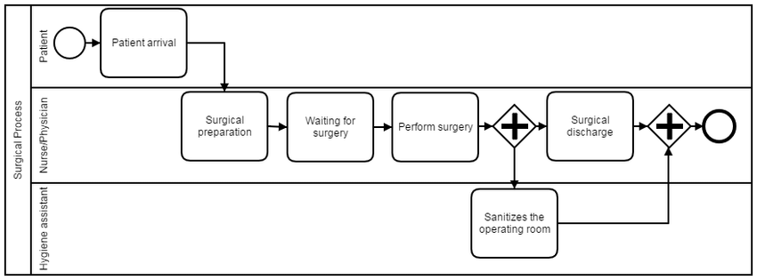
Simple example: BPMN model for surgery in a hospital

Slide 10
Process modeling lifecycle (kind of like SDLC)
Identify the process of interest
Learn about the process (discovery phase)
Analyze its strengths, weaknesses, gaps (SWAT)
Re-design it (if needed) or make changes
Implement
Monitor

Slide 11
Importance of Process Modeling:
To model a process leads to a number of questions :
Which steps are really necessary?
Who should do them?
Should they be kept in house or outsourced?
How they should be done?
What capabilities are needed?
What results do we expect and how will they be monitored?

Slide 12
Business Process Modeling Notation (BPMN)
BPMN is the standard for representing business processes
Many tools for designing BPMN processes:
TIBCO BPM (free), Oracle BPA

Slide 13

BPMN Basic Elements
Event: things that happen instantaneously
Task: unique of work that has a duration
Flow: imposes temporal constraints between objects
Gateway: element that controls the flow of the execution process
Notes:
https://www.diag.uniroma1.it/marrella/slides/Sem_PM_12-13_BPMN.pdf

Slide 14
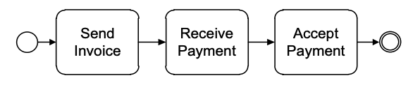
Connecting Activities – Simple RCM
Each process must have at east one start event (circle with in boarder)
Each process must have at least one end event (circle with double boarder)

Slide 15

Gateway: Controlling Flow
Exclusive Gateways (XOR)
Indicates locations within a business process where the sequence flow can take two or more alternative paths.
Only one of the paths can be taken.
Depicted by a diamond shape that may contain a marker that is shaped like an “X”.
Example: Based on the results of the initial assessment, the Exclusive Gateway routes the patient to one of the following paths, each leading to a different department:
General Ward
Specialty Care
Emergency Department (ED)

Slide 16

Gateway: Controlling Flow
Parallel Gateways (AND)
Provide a mechanism to synchronize parallel flows (AND-join) and to create parallel flows (AND-split), with activities that can be executed concurrently.
Enables multiple paths that do not depend on each other, can execute simultaneously, and all paths must be executed
Depicted by a diamond shape that must contain a marker that is shaped like a plus sign.
Example: sending a patient email notification, and updating a database can occur simultaneously in a business process.

Slide 17

Gateway: Controlling Flow
Inclusive Gateways (OR)
To model situations where a decision may lead to one or more options being taken at the same time, we need to use an inclusive (OR) split gateway.
An OR-split is similar to the XOR-split, but not all paths must be taken
When we encounter an OR-split, we thus take one or more branches depending on which conditions are true.
Example: Based on the type of medical service claimed and other factors such as the claim amount or patient's history, the gateway dynamically determines which of the following checks are necessary:
Medical Necessity Check
Policy Coverage Check
Fraud Analysis

Slide 18
Example: Invoice Mistakes
As soon as an invoice is received from a customer, it needs to be checked for mismatches.
The check may result in either of these three options:
There are no mismatches, in which case the invoice is posted;
There are mismatches but these can be corrected, in which case the invoice is re-sent to the customer
There are mismatches but these cannot be corrected, in which case the invoice is blocked.
Once one of these three activities is performed the invoice is parked and the process completes.

Slide 19
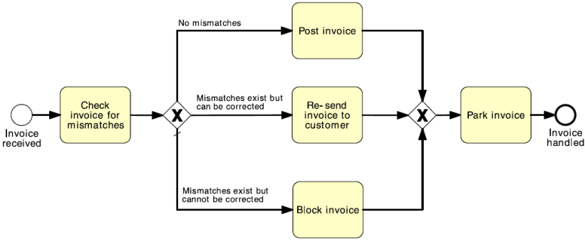
Example:

Slide 20
Pools and Lanes
In BPMN, resource classes are captured using Pools and Lanes:
Pools:
Represent independent organizational entities in a collaborative business process diagram, e.g., Customer is independent from the Supplier.
Independent means they do not share any common system that allows them to communicate implicitly. Hence, they have to communicate explicitly through the use of messages.

Slide 21
Pools and Lanes
In BPMN, resource classes are captured using Pools and Lanes:
Lanes:
Represent multiple resource classes in the same organizational space (i.e., in the same pool) and sharing common systems.
The IT Department and the Informatics Department of the same company may be represented in the same pool, but in different lanes. They can communicate directly.

Slide 22
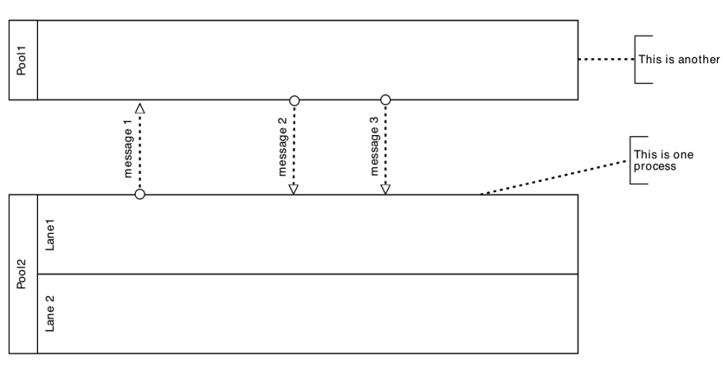
Template:

Slide 23
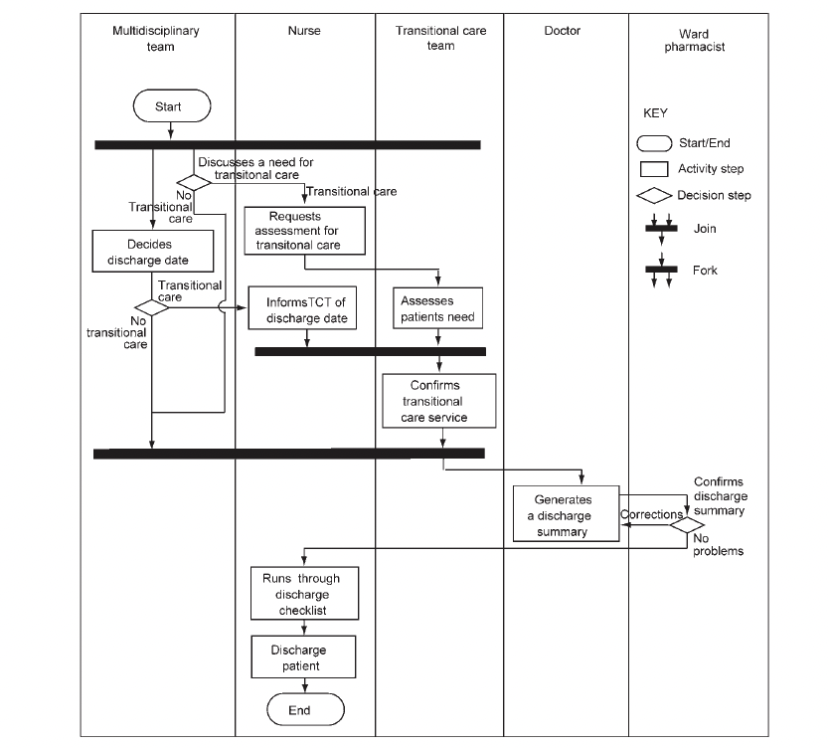
Swim lane – Patient Discharge
Reading: Health care process – Figure 5

Slide 24
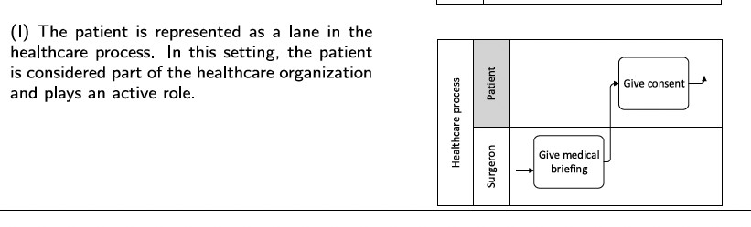
Different ‘swim’ lanes for participants
Reading: BPMN in healthcare – Table 3

Slide 25
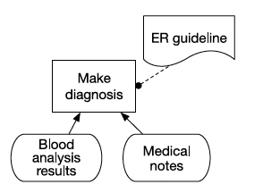
Part of BPMN: Decision Requirements Graph (DRG)
Reading: BPMN in healthcare – Fig 2

Slide 26
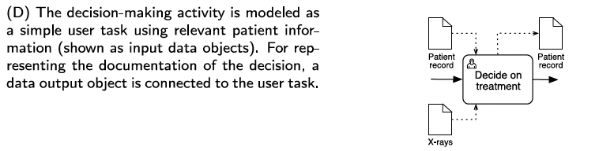
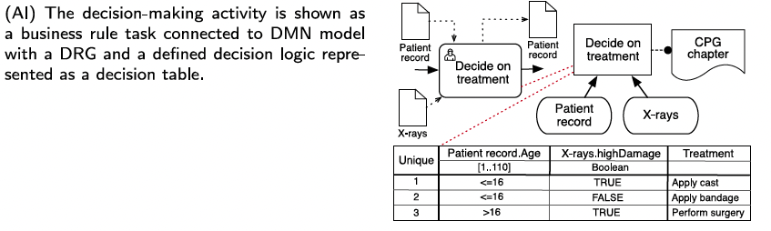
Incorporating EBM
Reading: BPMN in healthcare – Table 6

Slide 27
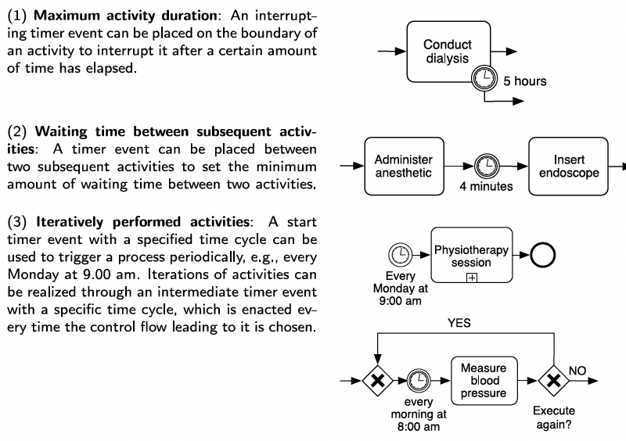
Temporal Constraints
Reading: BPMN in healthcare – Table 7

Slide 28
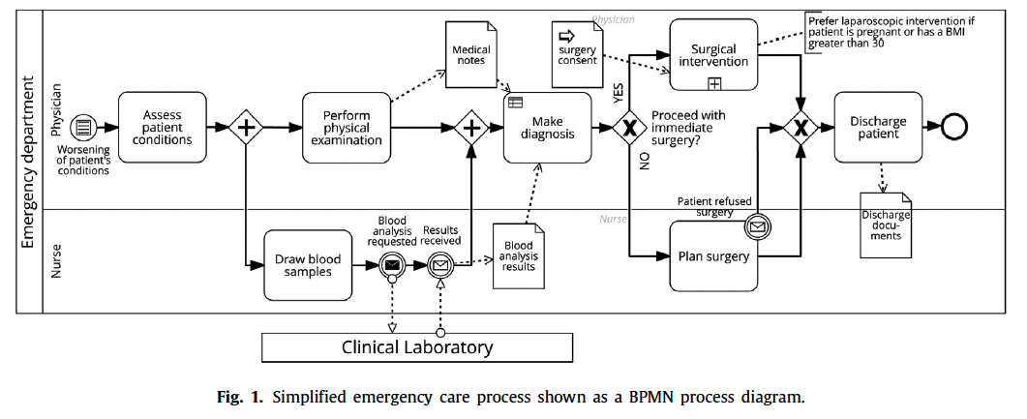
BPMN process diagram: ED Assessment
Reading: BPMN in healthcare – Fig 1

Slide 29
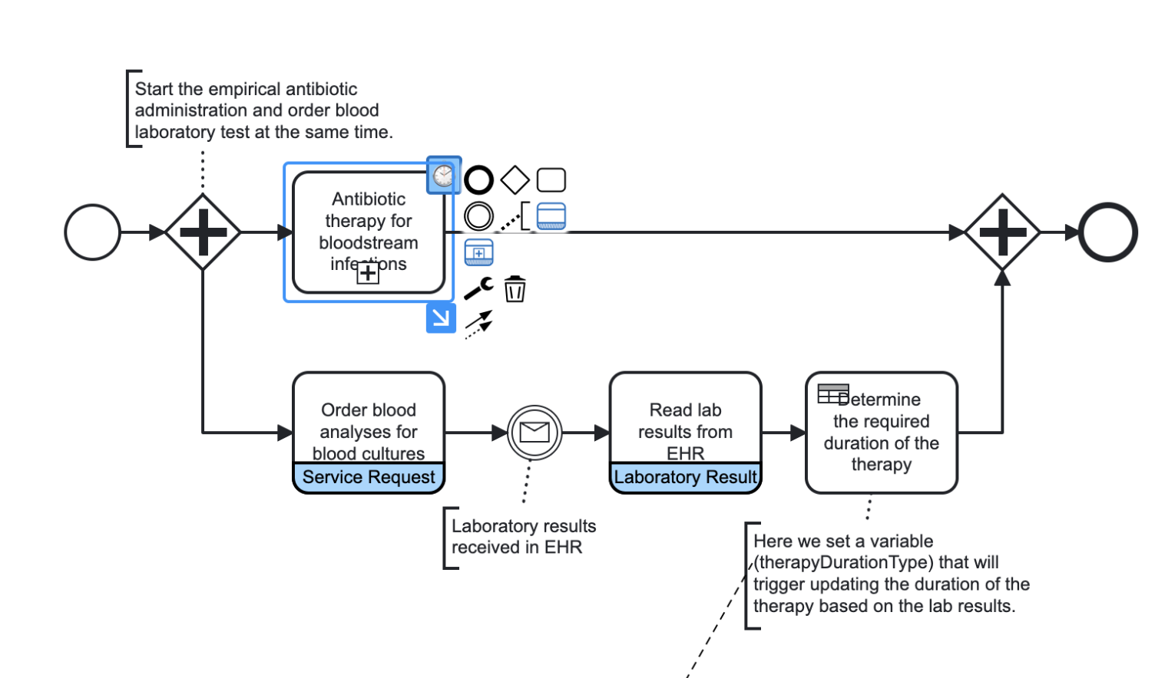
Antibiotic therapy for bloodstream infections
https://medicalflows.com/bpmn/examples/antibiotic-therapy-for-bloodstream-infections

Slide 30
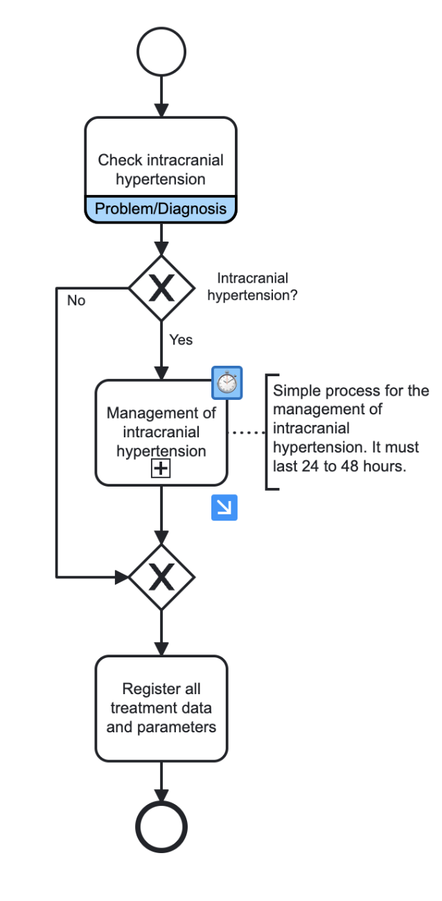
Example: Intracranial hypertension example for BPMN
https://medicalflows.com/bpmn/examples/intracranial-hypertension

Slide 31
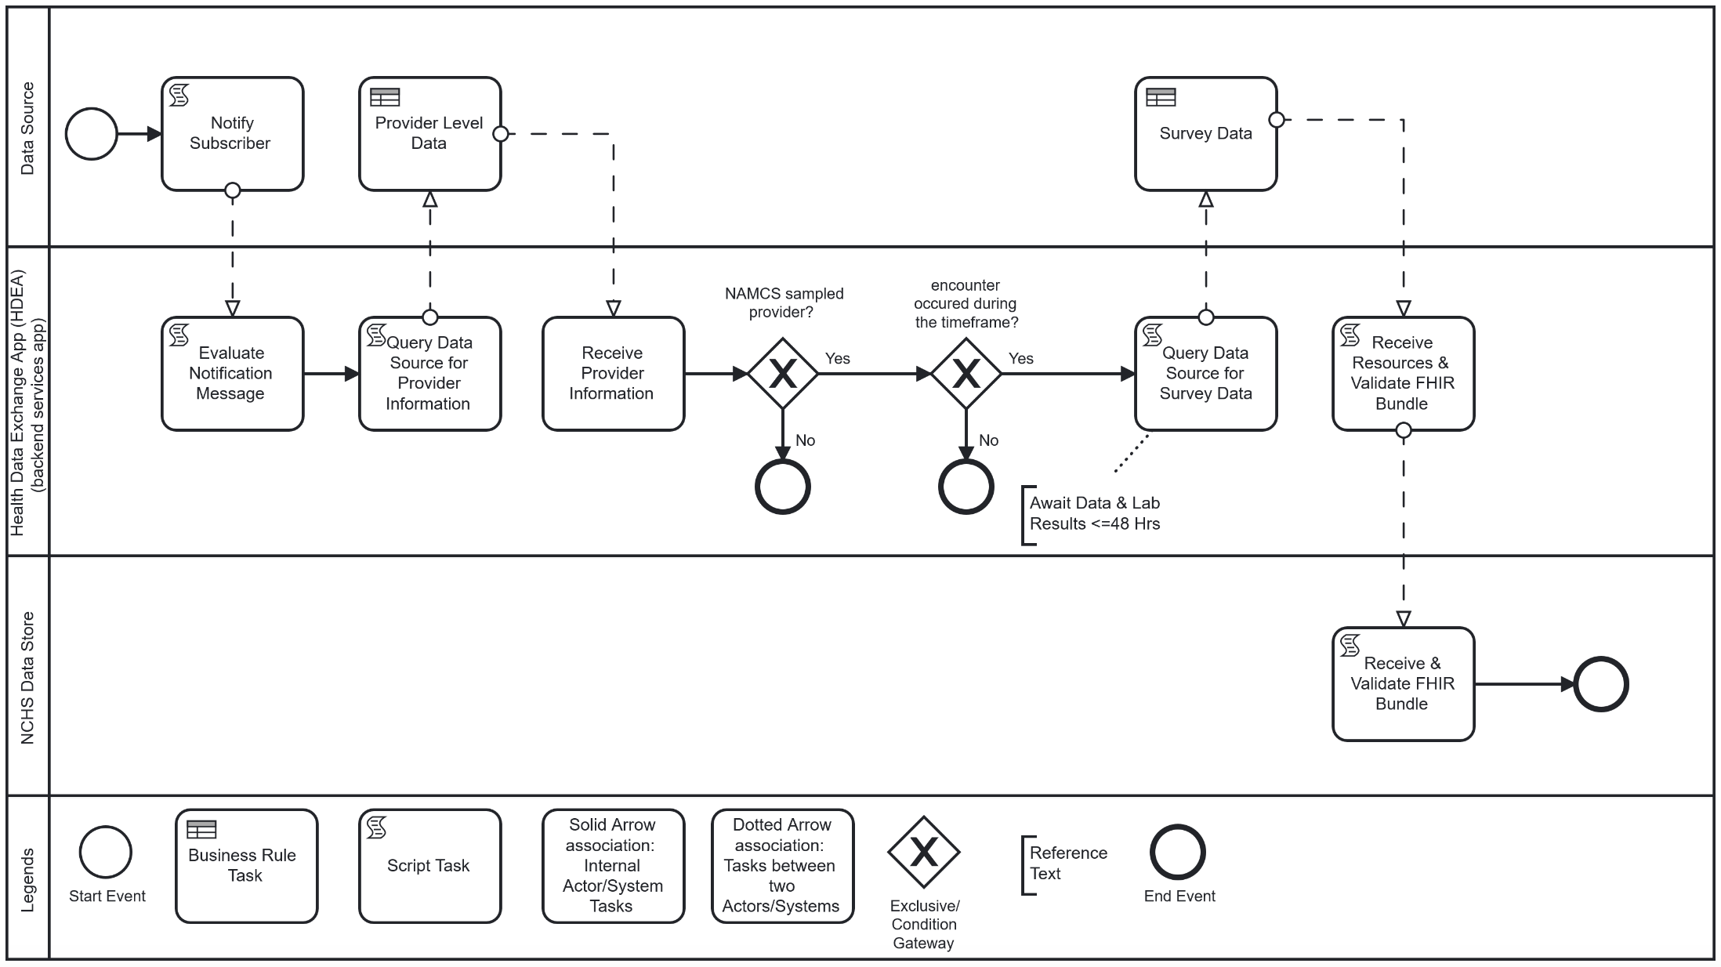
Example: Ambulatory Setting Health Care Survey Reporting Workflow
https://build.fhir.org/ig/HL7/fhir-health-care-surveys-reporting-ig/usecases.html

Slide 32
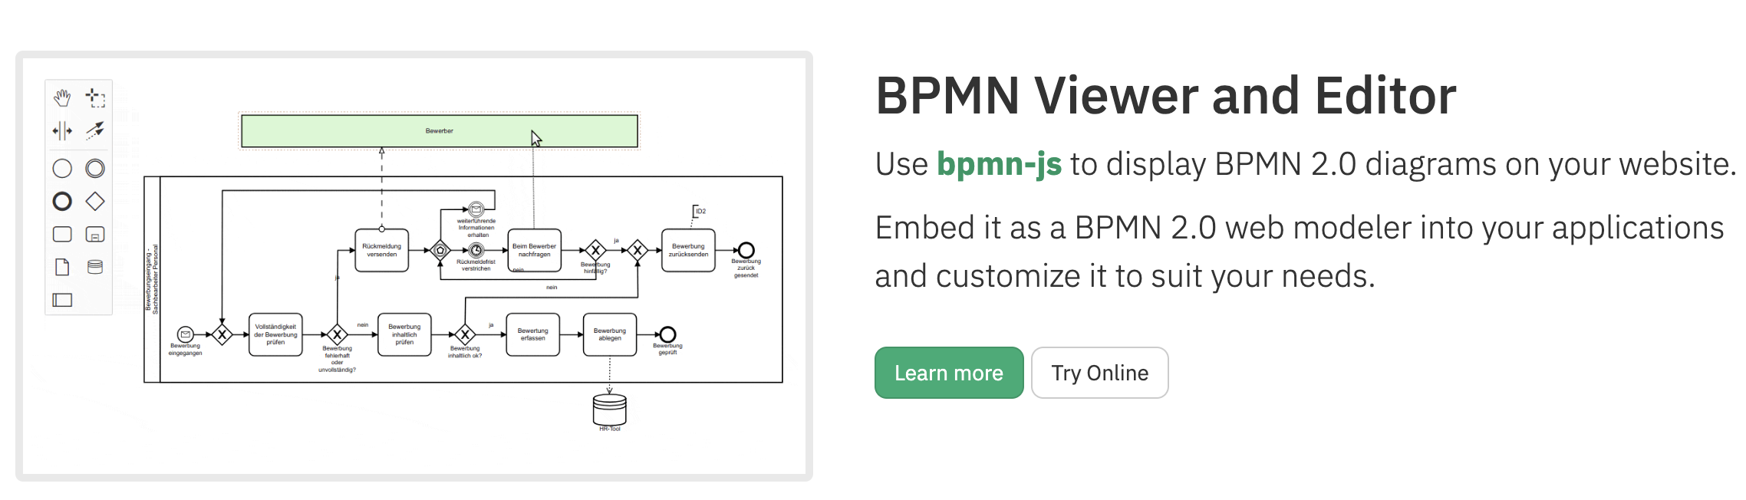
BPMN: https://bpmn.io/

Slide 33
Homework: Create BPMN to Capture User Interaction with CERNER HER
Process Flow Summary to Design:
The process starts when the patient logs into the EHR system.
The patient checks their lab results
An Exclusive Gateway assesses if the lab results are normal or abnormal.
If abnormal (Path A), the patient messages their provider [provider should be referenced in a separate lane but within the sample pool
If results are normal (Path B), the patient then schedules their next appointment.
Patient then reviews health education resources.
An Exclusive Gateway for the patient completing a questionnaire:
If successful, the process ends [6]
If unsuccessful because they forget to enter a mandatory item, a warning message appears, and then return to the start of the task
The process ends.

